Slide 1
Graphs
CSCI 4360/6360 Data Science II

Slide 2
Why graphs?
Lots of data is graphs
Facebook, Twitter, citation data, and other social networks
The web, the blogosphere, the semantic web, Freebase, Wikipedia, Twitter, and other information networks
Text corpora (like RCV1), large datasets with discrete feature values, and other bipartite networks
nodes = documents or words
links connect document → word or word → document
Computer networks, biological networks (proteins, ecosystems, brains, …), …
Heterogeneous networks with multiple types of nodes
people, groups, documents

Slide 3
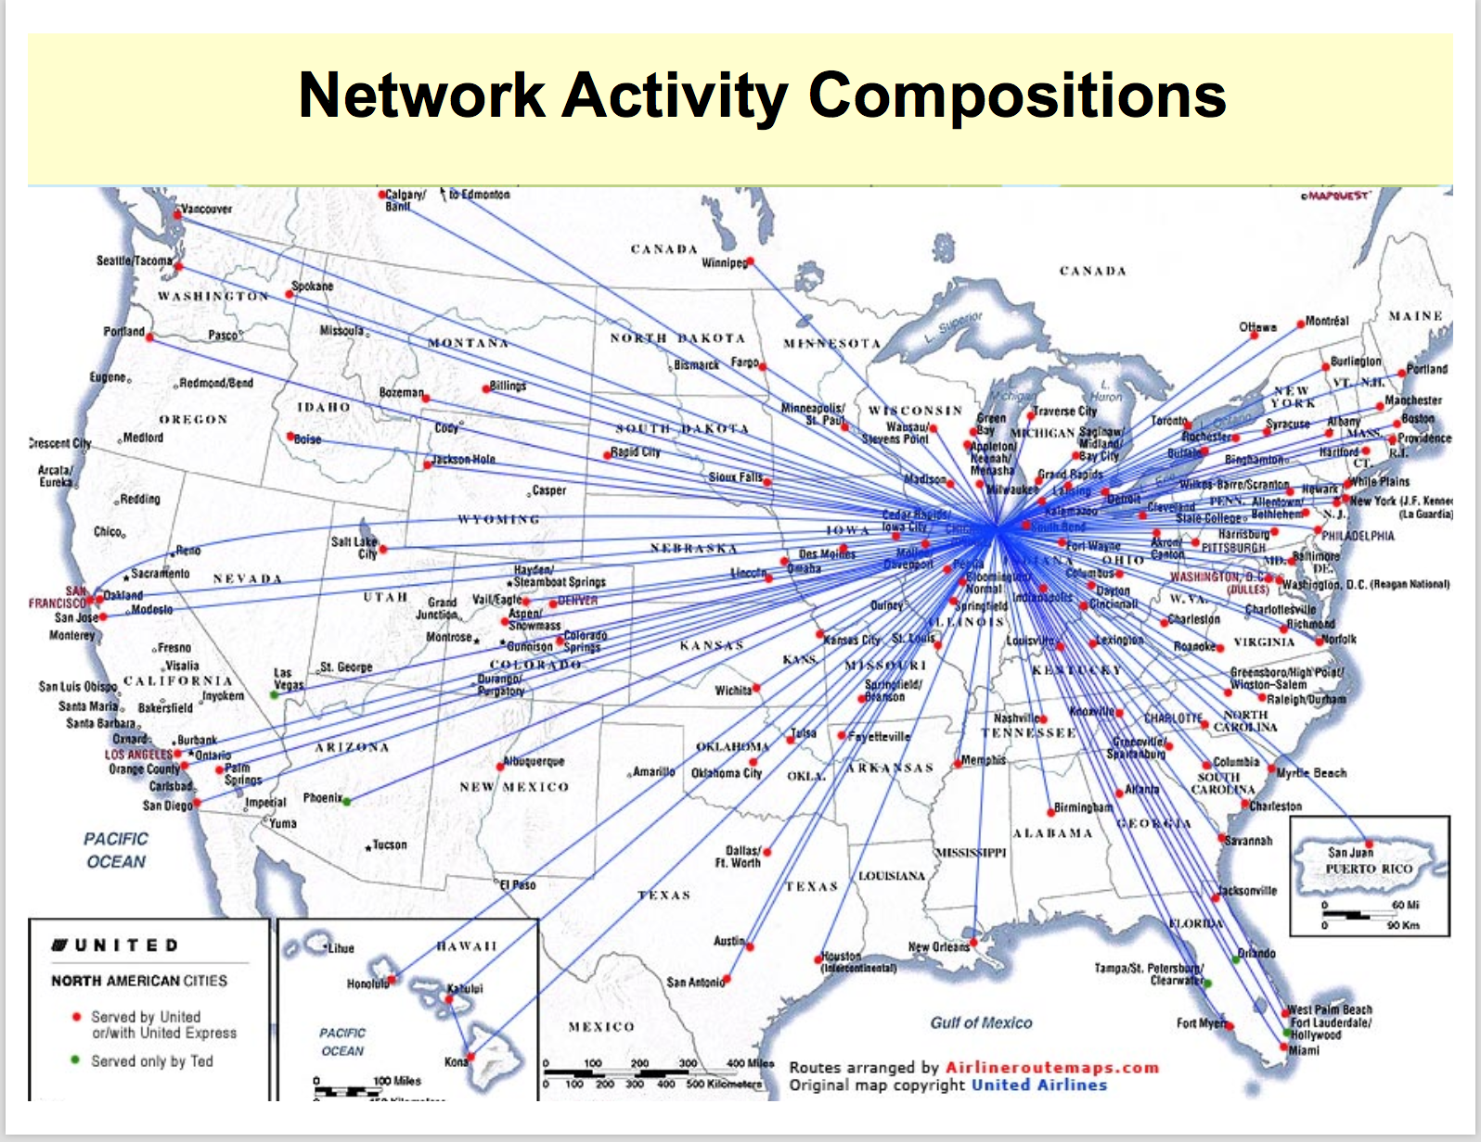
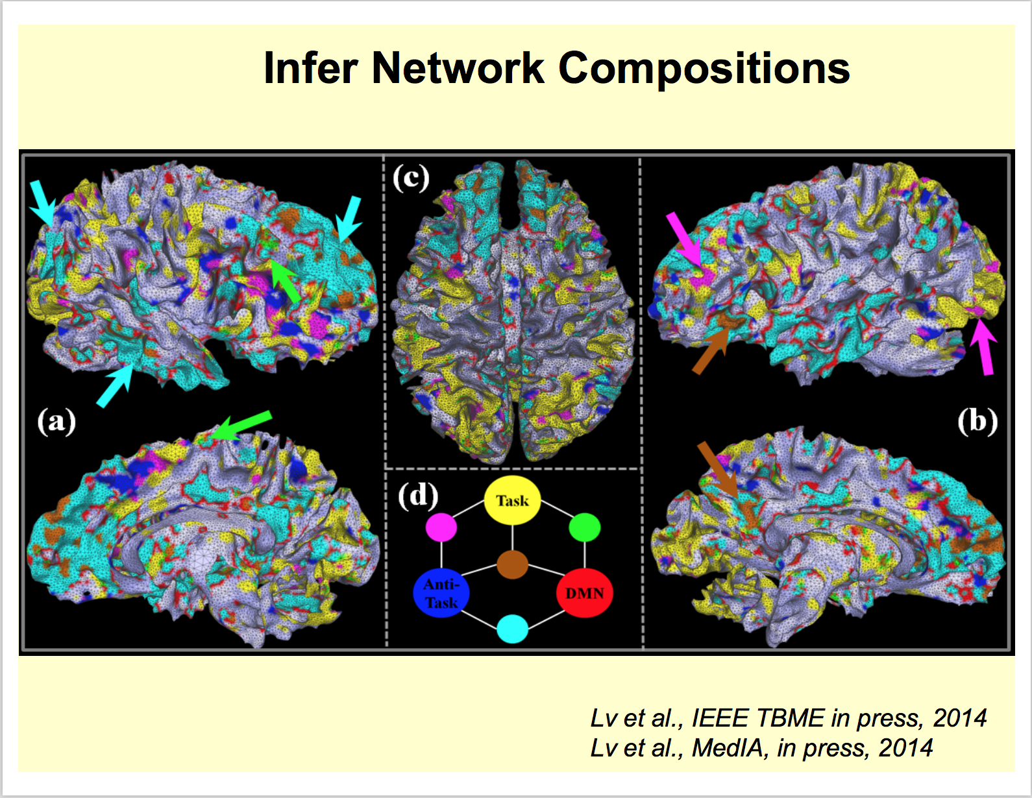
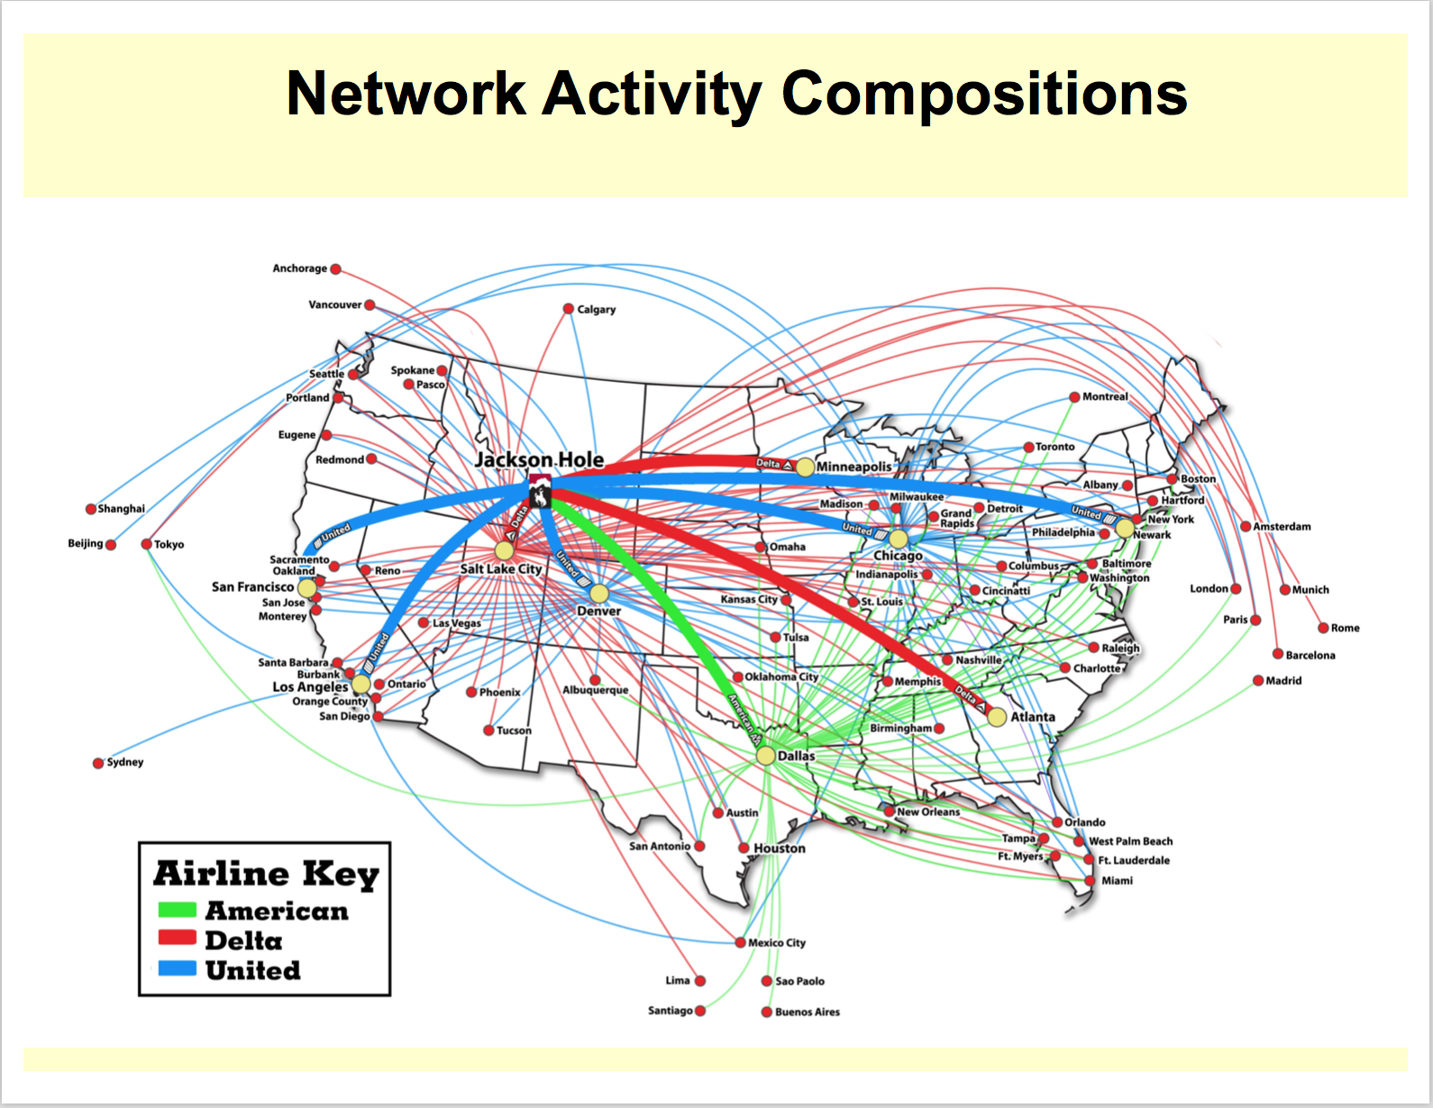
Last week
Airline flights
Functional brain networks

Slide 4
Properties of Graphs
Nodes & Edges
Set V of vertices/nodes v1, …
Set E of edges (u,v),…
Can be weighted/directed/labeled
Degree of v is # of edges on v
Indegree and outdegree for weighted graphs
Path is a sequence of edges (u1,v1),(u2,v2),…
Geodesic path between u and v is shortest path connecting them
Diameter is max _{u,v in V} {length of geodesic between u,v}
Effective diameter is 90th percentile
Mean diameter is over connected pairs
(Connected) component is subset of nodes that are all pairwise connected via paths
Clique is subset of nodes that are all pairwise connected via edges
Triangle is a clique of size three

Slide 5
Properties of Graphs
Descriptive statistics
Number of connected components
Diameter
Degree distribution
Centrality
…

Slide 6
Properties of Graphs
Models of formation and growth
Erdos-Rayni
Watts-Strogatz
Preferential attachment
Stochastic block models
…

Slide 7
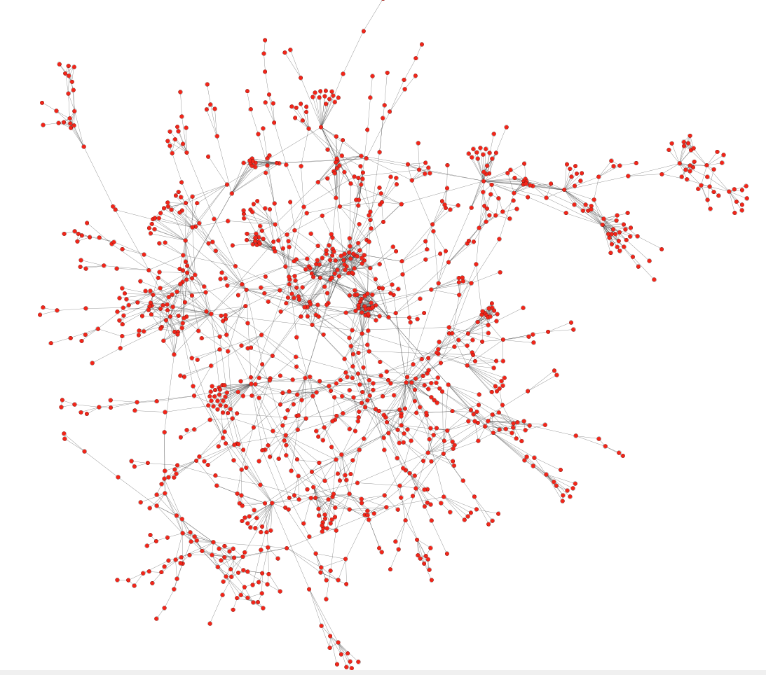
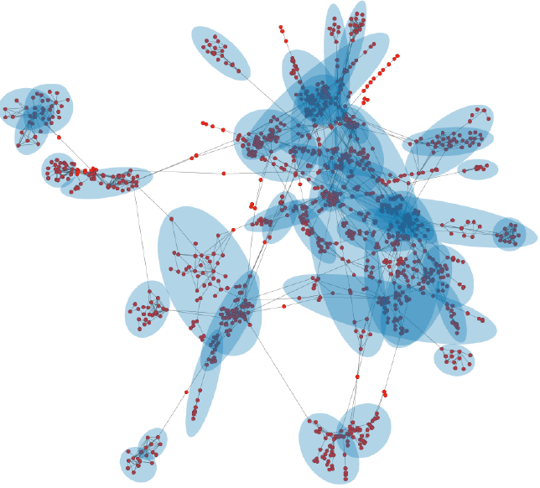
Biology
Can we identify functional modules?
Protein-protein interaction networks
Nodes: proteins
Edges: interactions
Functional modules

Slide 8
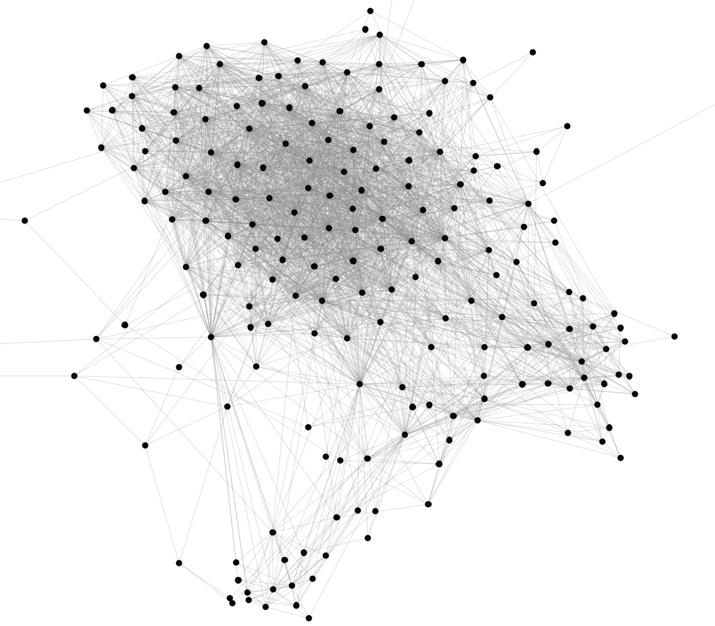
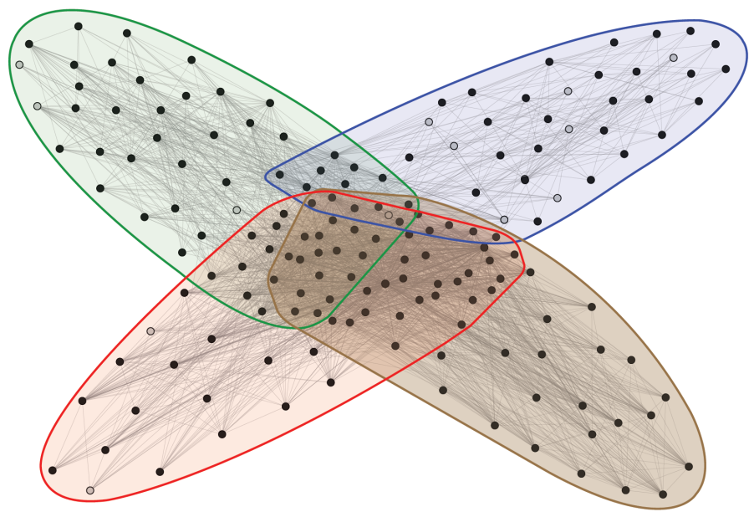
Facebook
Can we identify social communities?
Social communities
Nodes: Facebook users
Edges: Friendships
Social communities
High school
Summer internship
Stanford (Basketball)
Stanford (Squash)

Slide 9
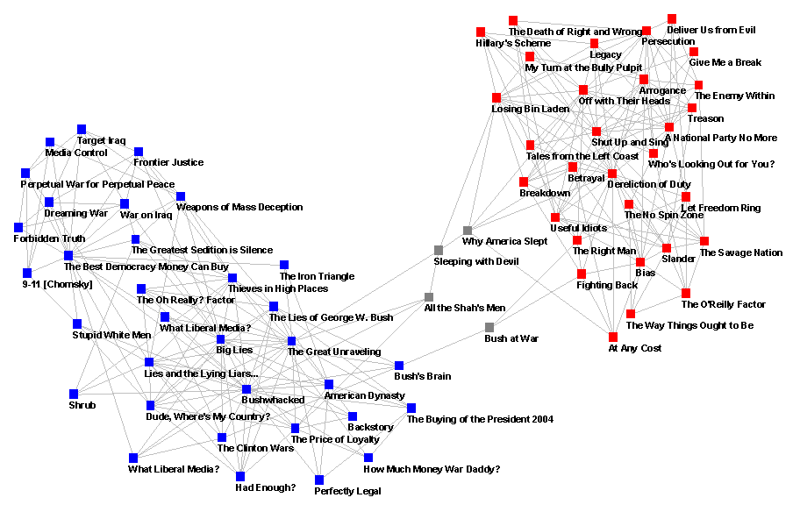
Blogs

Slide 10
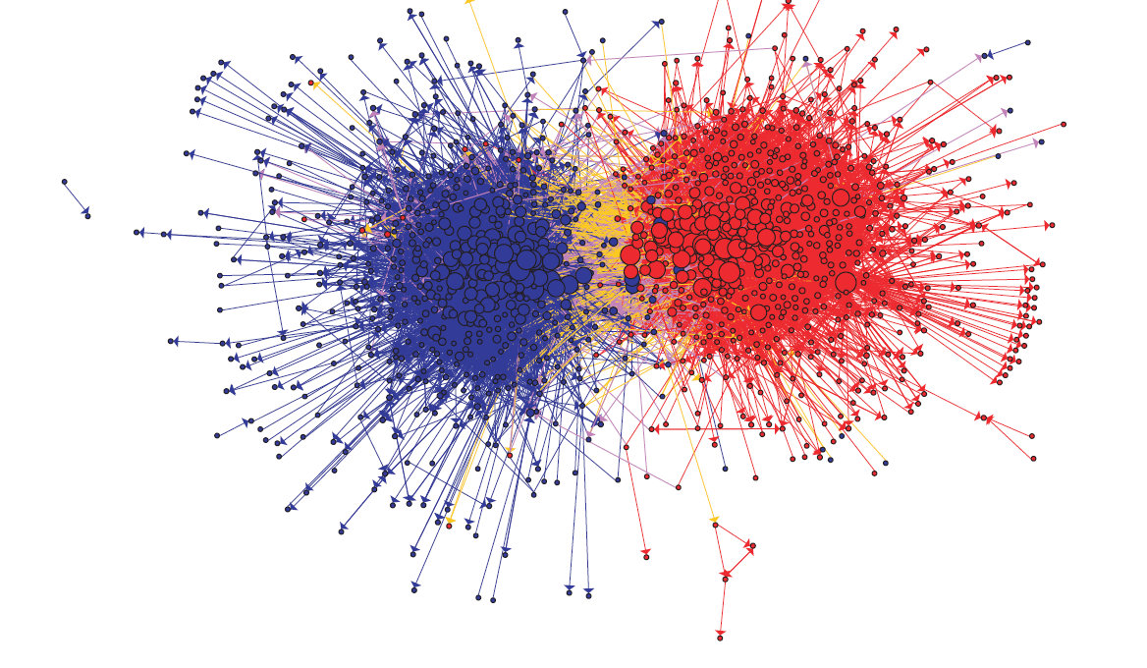
Blogs

Slide 11
Erdos-Renyi graphs
Take n nodes, and connect each pair with probability p
Mean degree is z=p(n-1)

Slide 12
Erdos-Renyi graphs
Take n nodes, and connect each pair with probability p
Mean degree is z=p(n-1)
Mean number of neighbors distance d from v is z^{d}
How large does d need to be so that z^{d} >=n ?
If z>1, d = log(n)/log(z)
If z<1, you can’t do it
So:
There tend to be either many small components (z<1) or one large one (z>1) giant connected component)
Another intuition:
If there are a two large connected components, then with high probability a few random edges will link them up.

Slide 13
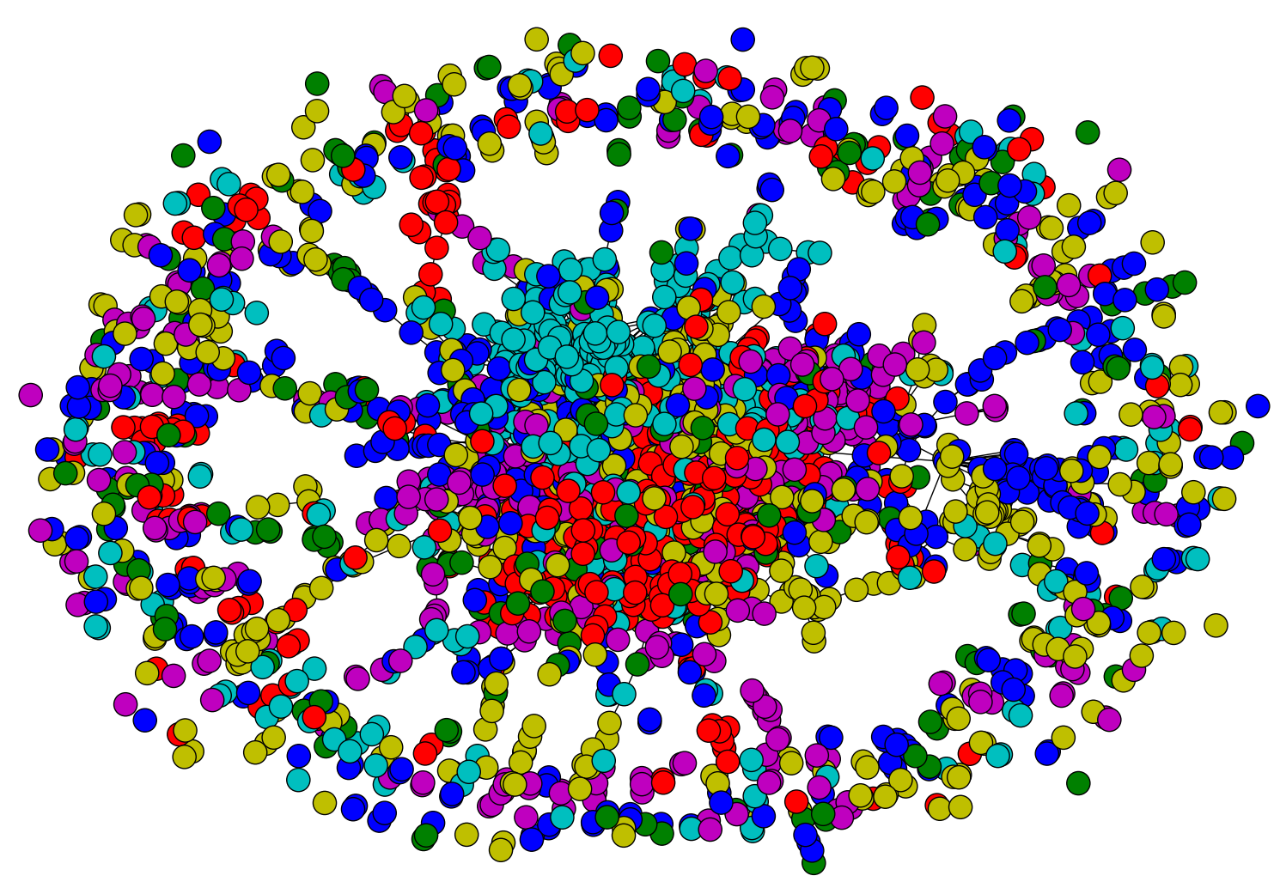

Slide 14
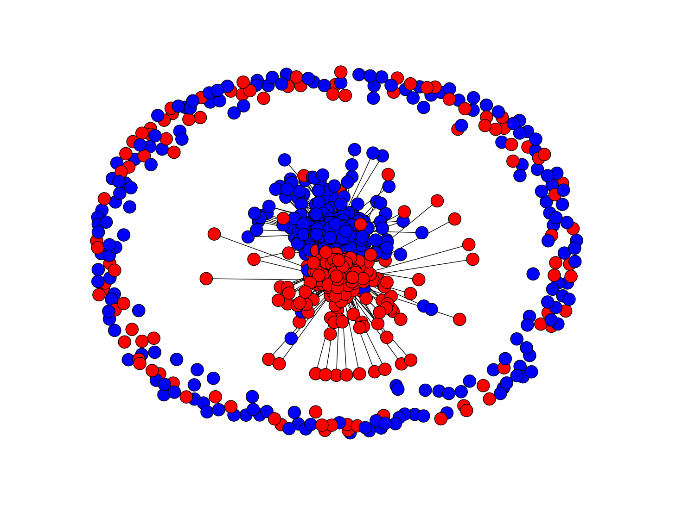
Notes:
blogs

Slide 15
Erdos-Renyi graphs
Take n nodes, and connect each pair with probability p
Mean degree is z=p(n-1)
Mean number of neighbors distance d from v is z^{d}
How large does d need to be so that z^{d} >=n ?
If z>1, d = log(n)/log(z)
If z<1, you can’t do it
So:
If z>1, diameters tend to be small (relative to n)

Slide 16
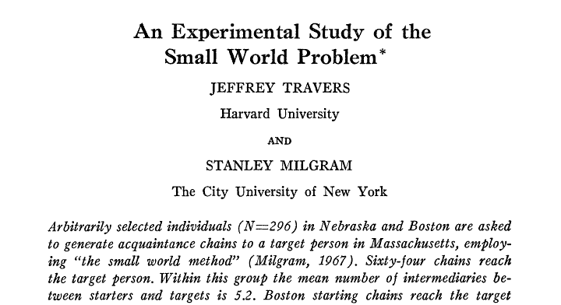
Sociometry, Vol. 32, No. 4. (Dec., 1969), pp. 425-443.
64 of 296 chains succeed, avg chain length is 6.2

Slide 17
Illustrations of the Small World
Milgram’s experiment
Erdős numbers
http://www.ams.org/mathscinet/searchauthors.html
Bacon numbers
http://oracleofbacon.org/
LinkedIn
http://www.linkedin.com/
Privacy issues: the whole network is not visible to all

Slide 18
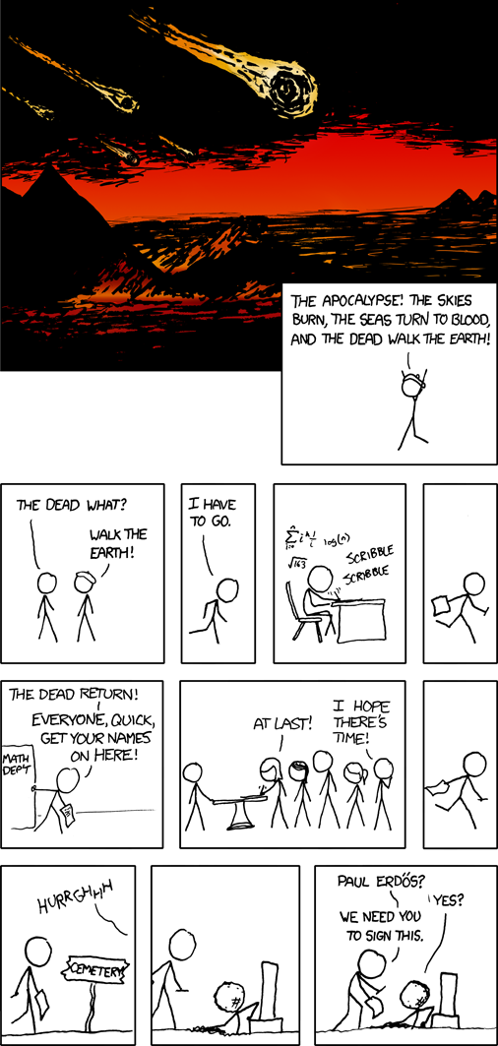

Slide 19
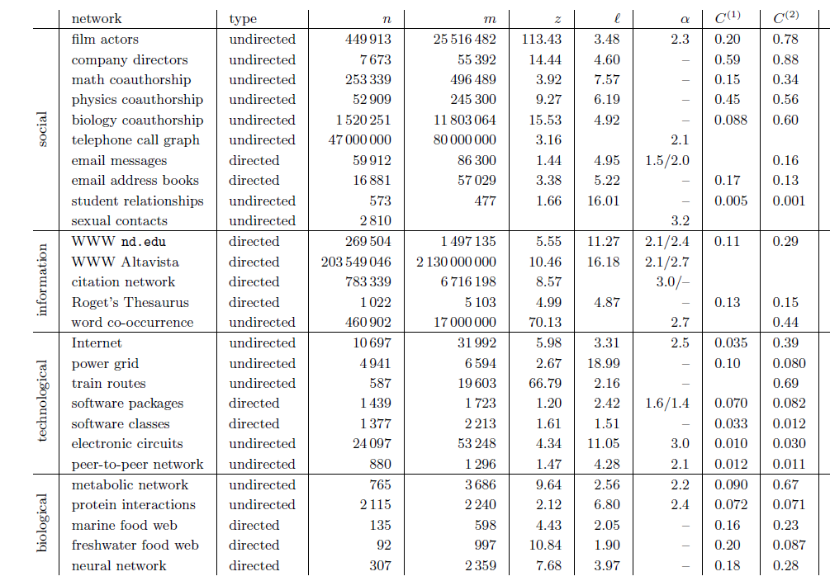

Slide 20
Erdos-Renyi graphs
A good model of degree distribution in ”natural” networks?

Slide 21
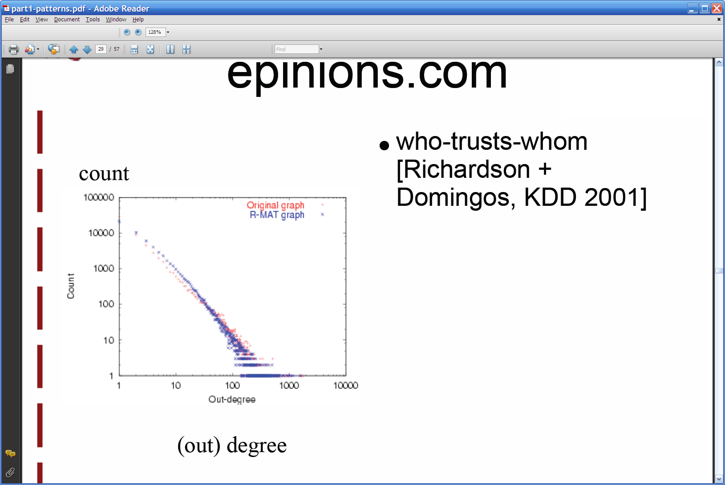
Degree distribution
Plot cumulative degree
X axis is degree
Y axis is #nodes that have degree at least k
Typically use a log-log scale
Straight lines are a power law; normal curve dives to zero at some point
Right: trust network in epinions web site from Richardson & Domingos

Slide 22
Degree distribution
Plot cumulative degree
X axis is degree
Y axis is #nodes that have degree at least k
Typically use a log-log scale
Straight lines are a power law; normal curve dives to zero at some point
This defines a “scale” for the network
Right: trust network in epinions web site from Richardson & Domingos

Slide 23
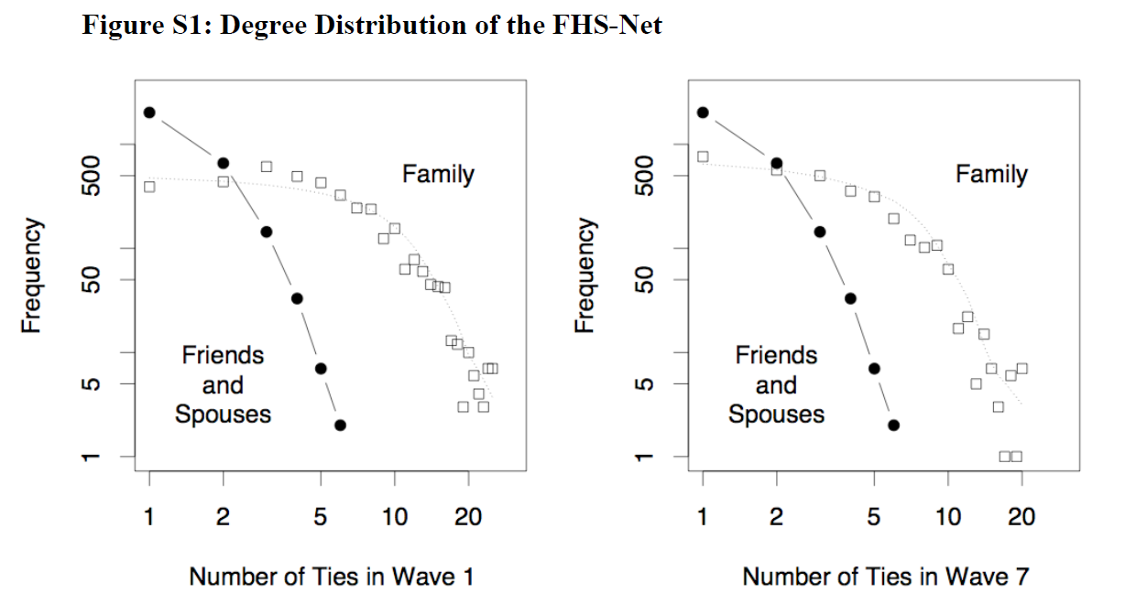
Friendship network in Framington Heart Study

Slide 24
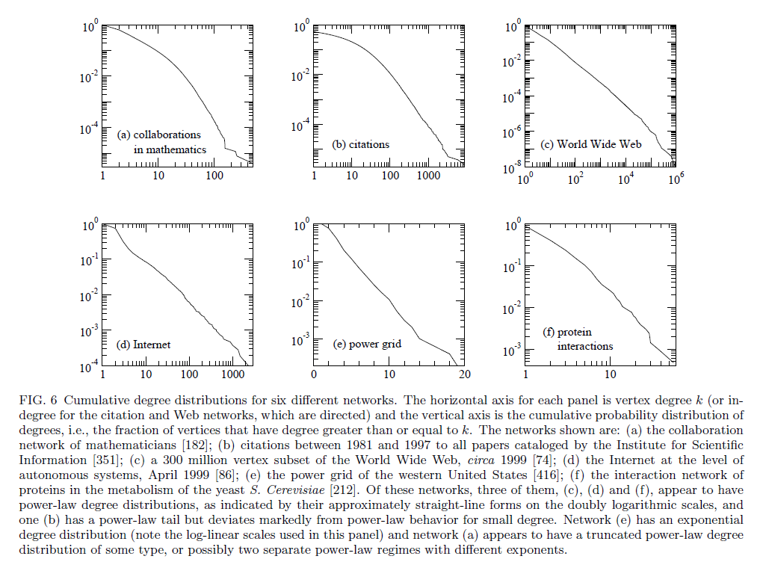

Slide 26
Graphs
Some common properties of graphs:
Distribution of node degrees
Distribution of cliques (e.g., triangles)
Distribution of paths
Diameter (max shortest-path)
Effective diameter (90th percentile)
Connected components
…
Some types of graphs to consider:
Real graphs (social & otherwise)
Generated graphs:
Erdos-Renyi “Bernoulli” or “Poisson”
Watts-Strogatz “small world” graphs
Barbosi-Albert “preferential attachment”
…

Slide 27
Graphs
Some common properties of graphs:
Distribution of node degrees: often scale-free
Distribution of cliques (e.g., triangles)
Distribution of paths
Diameter (max shortest-path)
Effective diameter (90th percentile) often small
Connected components usually one giant CC
…
Some types of graphs to consider:
Real graphs (social & otherwise)
Generated graphs:
Erdos-Renyi “Bernoulli” or “Poisson”
Watts-Strogatz “small world” graphs
Barbosi-Albert “preferential attachment” generates scale-free graphs
…

Slide 28
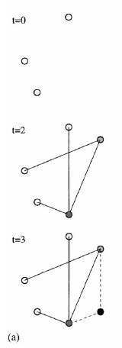
Barabasi-Albert Networks
Science 286 (1999)
Start from a small number of node, add a new node with m links
Preferential Attachment
Probability of these links to connect to existing nodes is proportional to the node’s degree
‘Rich gets richer’
This creates ‘hubs’: few nodes with very large degrees

Slide 29
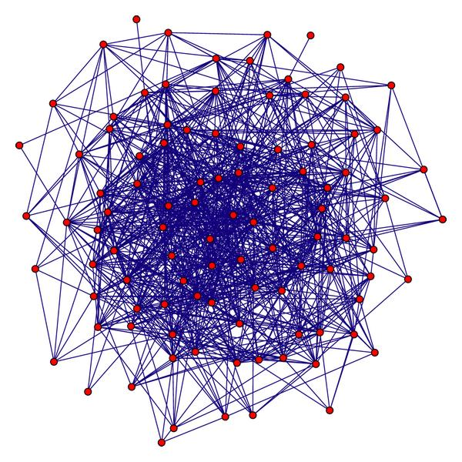
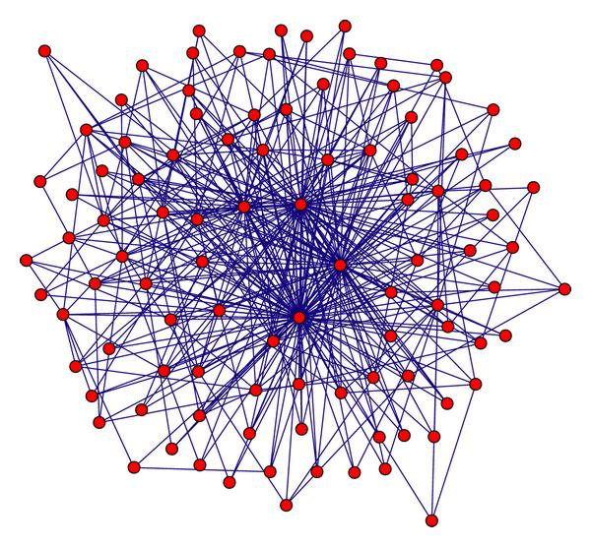
Random graph
(Erdos Renyi)
Preferential attachment
(Barabasi-Albert)
Notes:
Artificial graph

Slide 30
Graphs
Some common properties of graphs:
Distribution of node degrees: often scale-free
Distribution of cliques (e.g., triangles)
Distribution of paths
Diameter (max shortest-path)
Effective diameter (90th percentile) often small
Connected components usually one giant CC
…
Some types of graphs to consider:
Real graphs (social & otherwise)
Generated graphs:
Erdos-Renyi “Bernoulli” or “Poisson”
Watts-Strogatz “small world” graphs
Barbosi-Albert “preferential attachment” generates scale-free graphs
…

Slide 31
Homophily
One definition: excess edges between similar nodes
E.g., assume nodes are male and female and Pr(male)=p, Pr(female)=q.
Is Pr(gender(u)≠ gender(v) | edge (u,v)) >= 2pq?
Another definition: excess edges between common neighbors of v
Notes:
Closer this ratio is to 1, the more the neighbors of v are also connected to each other

Slide 32
Homophily
Another definition: excess edges between common neighbors of v

Slide 33
Homophily
In a random Erdos-Renyi graph:
Probably not realistic!
In a natural graph, two of your mutual friends might also be friends
Both in the same class or organization
You introduced them
They introduced you

Slide 34
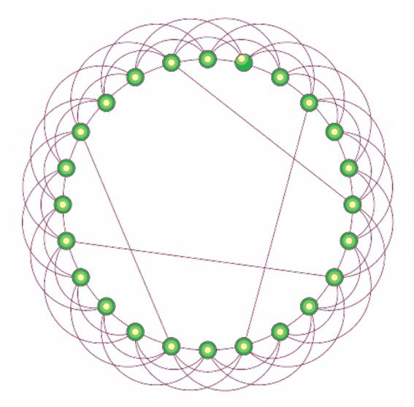
Watts-Strogatz model
Start with a ring
Connect each node to k nearest neighbors
➔ homophily
Add some random shortcuts from one point to another
➔ small diameter
Degree distribution not scale-free
Generalizes to d dimensions

Slide 36
Google’s PageRank
Inlinks are “good” (recommendations)
Inlinks from a “good” site are better than inlinks from a “bad” site
but inlinks from sites with many outlinks are not as “good”...
“Good” and “bad” are relative.
web site xxx
web site xxx
web site xxx
web site a b c d e f g
web
site
pdq pdq ..
web site yyyy
web site a b c d e f g
web site yyyy

Slide 37
Google’s PageRank
web site xxx
Imagine a “pagehopper” that always either
follows a random link, or
jumps to random page
web site xxx
web site a b c d e f g
web
site
pdq pdq ..
web site yyyy
web site a b c d e f g
web site yyyy

Slide 38
Google’s PageRank (Brin & Page, http://www-db.stanford.edu/~backrub/google.html)
web site xxx
Imagine a “pagehopper” that always either
follows a random link, or
jumps to random page
PageRank ranks pages by the amount of time the pagehopper spends on a page:
or, if there were many pagehoppers, PageRank is the expected “crowd size”
web site xxx
web site a b c d e f g
web
site
pdq pdq ..
web site yyyy
web site a b c d e f g
web site yyyy

Slide 39
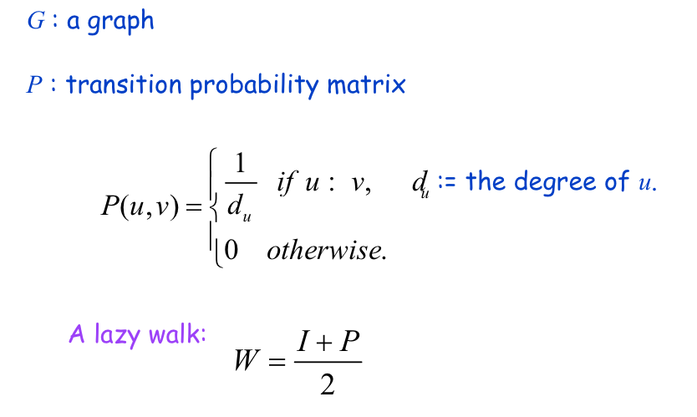
Random Walks
avoids messy “dead ends”….

Slide 40
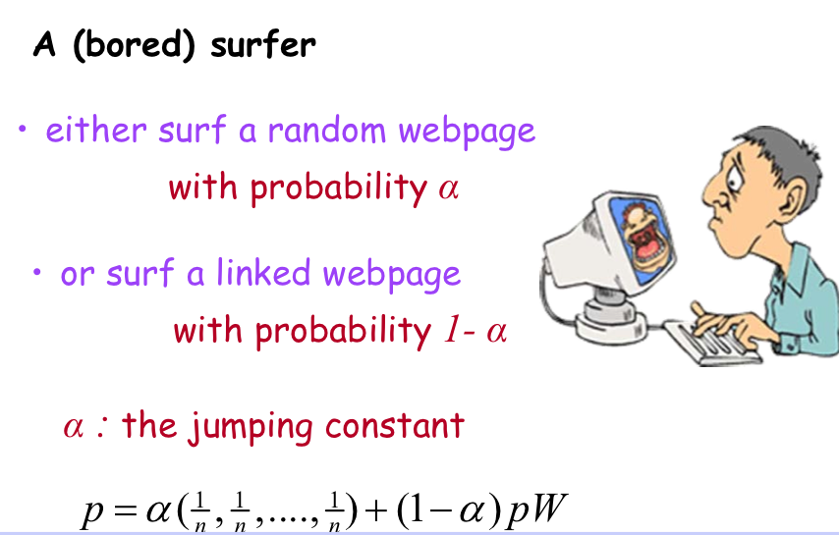
Random Walks: PageRank

Slide 41
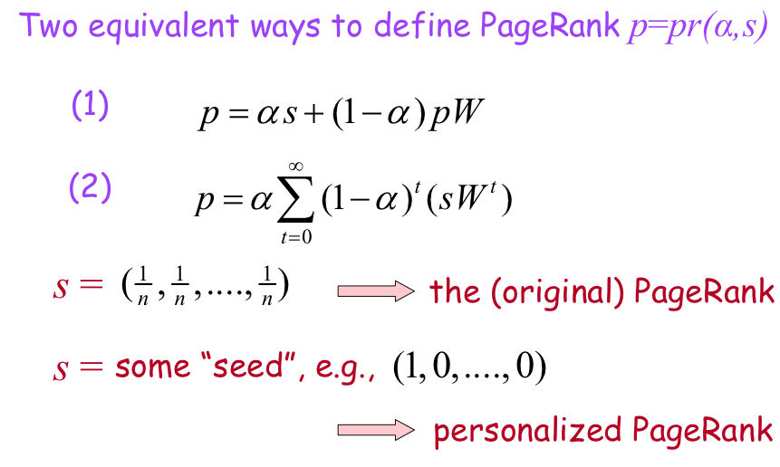
Random Walks: PageRank

Slide 42
Graph = Matrix Vector = Node → Weight
M
v
 | A | B | C | D | E | F | G | H | I | J
A | _ | 1 | 1 |  |  | 1
B | 1 | _ | 1
C | 1 | 1 | _
D |  |  |  | _ | 1 | 1
E |  |  |  | 1 | _ | 1
F | 1 |  |  | 1 | 1 | _
G |  |  |  |  |  |  | _ |  | 1 | 1
H |  |  |  |  |  |  |  | _ | 1 | 1
I |  |  |  |  |  |  | 1 | 1 | _ | 1
J |  |  |  |  |  |  | 1 | 1 | 1 | _
 | A
A | 3
B | 2
C | 3
D
E
F
G
H
I
J
C
A
B
G
I
H
J
F
D
E

Slide 43
PageRank
Let u = (1/N, …, 1/N)
dimension = #nodes N
Let A = adjacency matrix: [a_{ij}=1 ⬄ i links to j]
Let W = [w_{ij} = a_{ij}/outdegree(i)]
w_{ij} is probability of jump from i to j
Let v⁰ = (1,1,….,1)
or anything else you want
Repeat until converged:
Let v^{t+1} = cu + (1-c)Wv^{t}
c is probability of jumping “anywhere randomly”

Slide 44
Points of order
How is Assignment 3 going?
Midterm Exam is 1 week from today (Oct 3).
All lecture materials and homeworks are fair game
Less emphasis on guest lectures
Some multiple choice, some short answer, some programming
Final project proposals are due Thursday, Oct 12
1-2 pages (absolute maximum, including references)
Who are you working with?
What is your research question, & what do you expect to learn about it?
How will you validate your results?
What data, tools, and infrastructure are you working with?
Provide a tentative timeline & division of responsibilities

